Slide 1
Week 1: Introduction To Input And Output Devices
JHS 1 Computing Lesson

Slide 2
Introduction
A computer is a machine that helps us process information. But a computer cannot work on its own it needs a way for us to give it instructions and a way to show us results. This is where input and output devices come in.

Slide 3
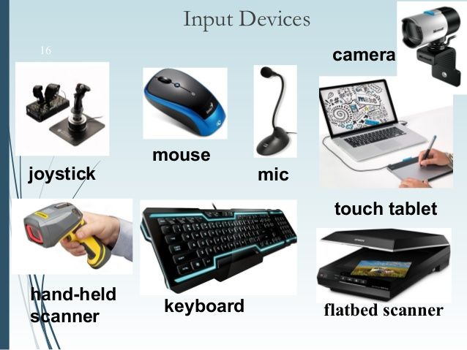
Input Devices
Input devices are used to send information to the computer.
Examples:

Slide 4
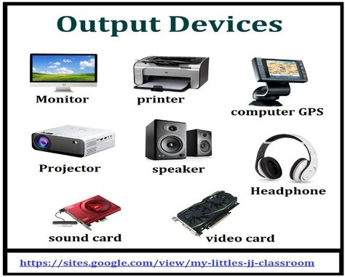
Output Devices
Output devices are used to receive information from the computer.
Examples:

Slide 5
Summary
: Input devices are hardware (physical parts of the computer) that we use to enter data, instructions, or commands into the computer.
But output devices are hardware that the computer uses to give us results or information after processing.

Slide 6
Activities
Write down three input devices you have seen before.
2. Write down three output devices you have seen before.

